Slide 1

Financing the Future of Food:
A Case Study of the Global Agriculture and Food Security Program (GAFSP) and Lessons for Donors/CSOs
Neil Watkins, Director of Policy and Campaigns, ActionAid USA
April 20, 2012

Slide 2
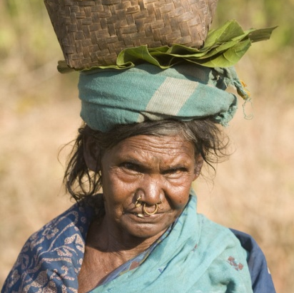
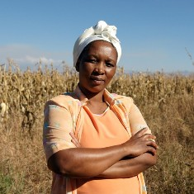
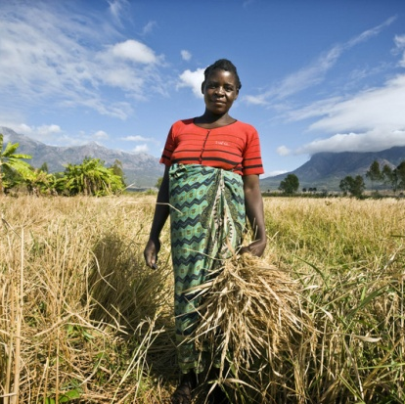
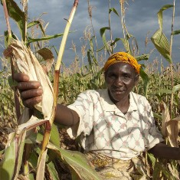
Background - GAFSP
GAFSP was established in April 2010, following commitments from the G8 in 2009 and the G20 in Pittsburgh.
Funding: The fund, with a small secretariat at the World Bank, has received nearly $1 billion in pledges from donors including the United States, Spain, Korea, the Bill and Melinda Gates Foundation, Canada, Ireland, and Australia. Public Sector Window and Private Sector Window
Principles: The fund embodies many of the principles of aid effectiveness, including country ownership, a strong monitoring and evaluation element, and provisions to ensure transparency and civil society participation.
Process: Call for proposals; projects must emanate from CAADP-like country investment plan; review by TAC; approval by Steering Committee; Implementation with Supervising Entity.

Slide 3
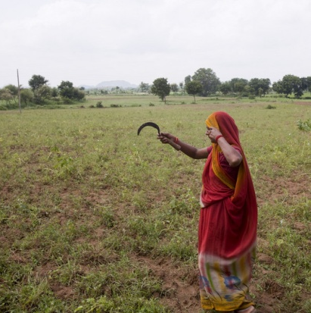
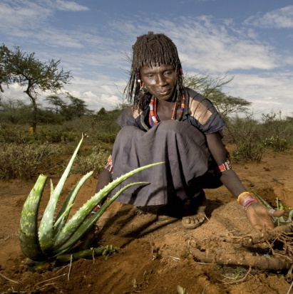

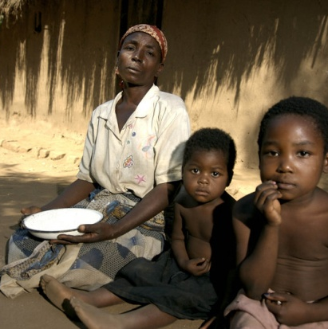
Governance of the GAFSP (Public Sector Window)
One of the innovations of the GAFSP is its governance structure. It is governed by a Steering Committee with 12 voting members (6 donors, along with 6 developing country governments), as well as 11 non-voting but fully participating members.
Non-voting members: 3 CSOs (including ActionAid and a farmers’ organization leader from Africa - ROPPA and Asia – Asian Farmers Association); 3 representatives from the UN system; and representatives from the IFIs which serve as the supervising entities for GAFSP projects.
Little difference in practice between voting and non-voting members: all discussions and decisions are taken with all members present.

Slide 4
Projects Funded by GAFSP Public Sector Window
By the end of 2011, GAFSP had provided more than $500 million in grants to 12 countries.
In Liberia, GAFSP funds (via AfDB) are targeted at low-income households in 4 countries with high potential for rice farming. The project will ensure that the majority of women and youth headed households are beneficiaries.
In Rwanda, GAFSP (via World Bank) funds are being used to scale up interventions that reduce erosion on steep hillsides and help bolster productivity
In Togo, the GAFSP project (via IFAD) supports farmers to organize themselves and to access inputs, extension and credit.

Slide 5
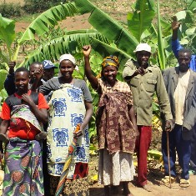
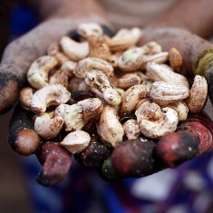
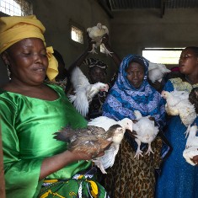
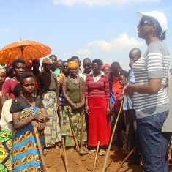
Civil society participation within GAFSP Public Sector Window
Vital to any conception of “partnership” on rural development is that farmers, especially women, their organizations, families, and communities are genuinely involved in shaping national plans, project design and implementation.
From the outset, the GAFSP has placed a strong emphasis on civil society participation. CSOs are partners with donors and other actors in the process:
Civil society presents input from non-state actors in the country in SC discussions on project approval
Post project approval, GAFSP Southern CSO SC reps travel to countries to connect in country CSOs/farmers with governments/supervising entities. Goal is to set up multi-stakeholder project oversight groups to enhance accountability

Slide 6
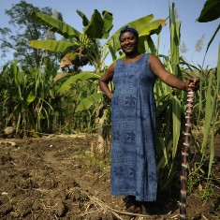
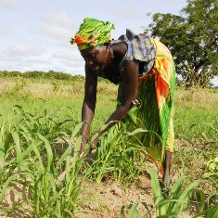
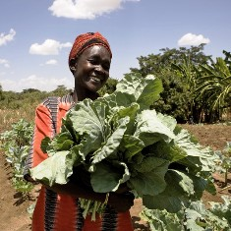
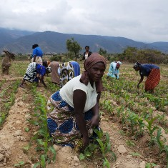
Civil society participation within GAFSP Public Sector Window
Some examples of GAFSP policies in support of participation, secured due to advocacy by CSOs and like minded governments/entities:
Instructions are sent along with grant notices directing the countries to ensure meaningful stakeholder participation in the finalization of their proposals.
The project financed by GAFSP through IFAD in Togo is a good model for how to involve farmers’ organizations and civil society organizations in the drafting, finalization, and now implementation of the project.
At the request of the full GAFSP steering committee, CSOs developed detailed benchmarks and guidelines for effective civil society participation at the country level to ensure even better results. These innovative guidelines are included in the January 2012 call for proposals.

Slide 7
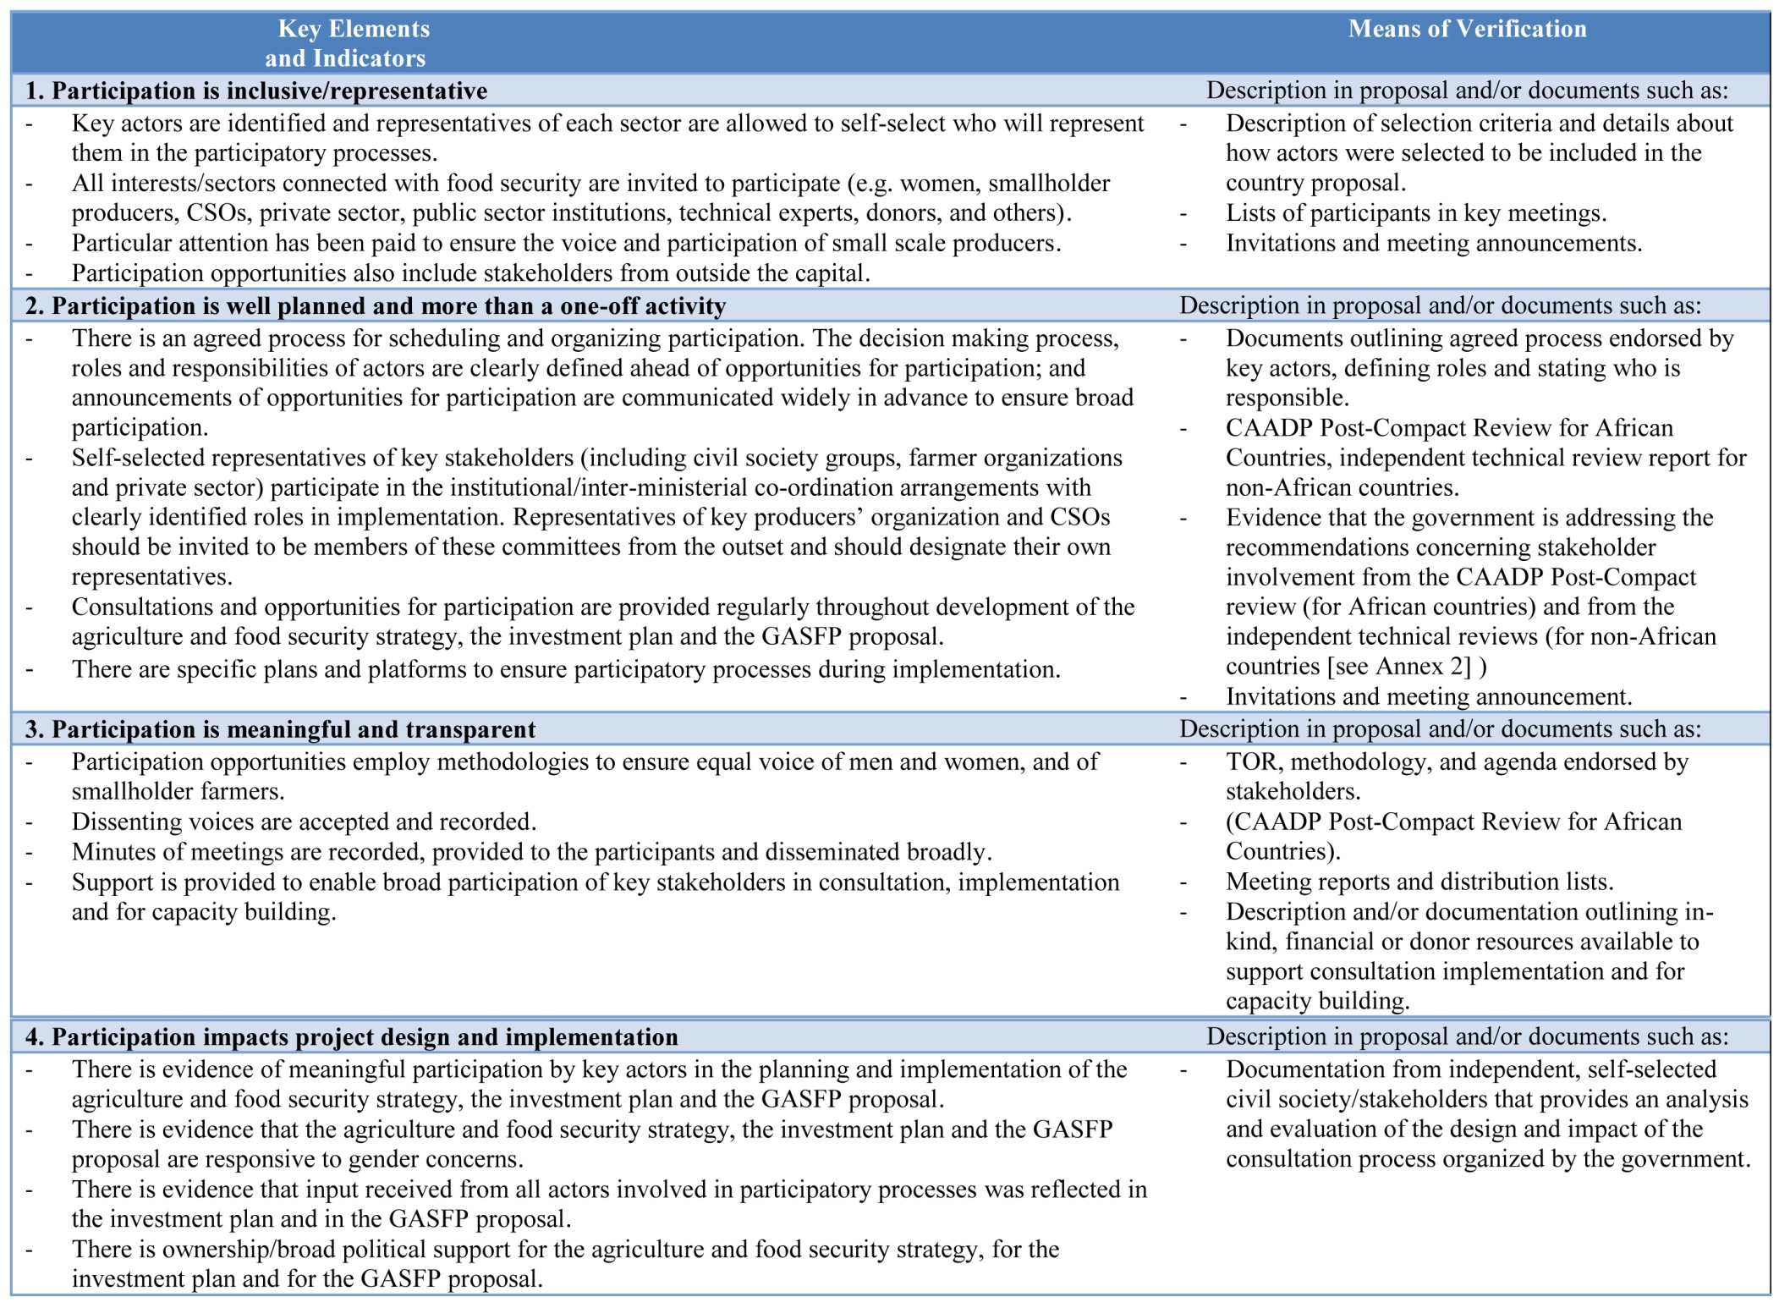
GAFSP Quality of Participation Guidelines

Slide 8
Challenges
While GAFSP is an innovative model on many fronts, civil society continues to push for further reforms:
While CSOs/farmer organizations are well represented at the Steering Committee, experience varies at country level and could be improved.
The GAFSP could do more to incentivize “innovative” projects that actively target the poorest and most marginalized farmers, not just scale up existing projects
GAFSP could more strongly support agroecological approaches and sustainable methods
The GAFSP Private Sector Window is especially problematic:
  Not subject to same governance model – no CSO role
  Less transparency
  Development indicators have been unclear or insufficient to assess development impact of investments

Slide 9
Recommendations for Improvements
While GAFSP is an innovative model on many fronts, civil society continues to push for further reforms:
Supply Side (GAFSP Fund)
More effort by GAFSP CU and SEs to link SE reps/govts in country with CSOs and farmer orgs, and to incentivize and create space for farmer/CSO engagement in development and implementation
Stronger incentives in next Call for Proposals / TAC guidelines to incentivize “innovative” projects that actively target the poorest and most marginalized farmers, and agroecology
Demand side (country plans and projects)
CSOs/farmers should intensify engagement with CAADP/NAIP and GAFSP project processes in country as these are what GAFSP projects emanate from – to ensure proposals that emphasize agroecology/real needs of smallholders

Slide 10
Lessons for Other donors, CSOs
GAFSP innovations could strengthen World Bank ARD lending/other donor initiatives in ag sector:
Supports country plans
Quality of other bilateral/multilateral FS initiatives could be strengthened by including numerous stakeholders including civil society.
GAFSP fund incentivizes CSO participation with Quality of Participation guidelines – which increases accountability.

