Slide 1
Boosting Non State Actor participation in CAADP
Yaoundé 24th March
7Th CAADP PP
CAADP NSA Coordination Task Team

Slide 2
Presentation outline
Introduction-
  Why NSA
  Who are the NSAs
  The Value we add to the CAADP process
Progress to date
Challenges Identified
Over view of the NSA Guidelines
Desired outcome for NSA participation
Boosting NSA participation a case of Nigeria and Malawi
Next steps

Slide 3
Why Non-State Actors?
CAADP recognizes that to transform African agriculture it is imperative to build broad and inclusive coalitions...
The 6th CAADP PP (April 2010) recognised poor quality of non-state actor participation. More inclusion of non-state actors, especially poor and marginalised communities, at all levels is needed.
NSA are a large part of the implementers of CAADP. Without them we could have great CAADP investment plans but there will be weak results, accountability and sustainability

Slide 4
Who are NSA?
Private Sector
Farmer Associations
National & International NGOs
Community based organisations
Academic & Research Community
Media organisations
Development partners

Slide 5
We add value to the CAADP process
Putting CAADP plans into action
Raising awareness and engaging private sector
Raising awareness and mobilizing the public from National to community level
Knowledge generation and sharing best practices
Advocacy to governments, donors and other stakeholders to support the CAADP process
Capacity development of national and regional stakeholders
Increasing CAADP engagement with women & youth

Slide 6
Progress to date
The formation of the Task Team.
Stocktaking exercise to develop guidelines for boosting NSA participation in CAADP processes.
Options paper -Consultation workshop –Guidelines finalised
Guidelines available – insert www link
First planning workshop

Slide 7
Overview of NSA Guidelines
Section 1 clarifies role of Non State Actors in the CAADP process;
Section 2 examines the country-level. It promotes the country team as the nexus for ensuring effective Non State Actor participation and makes a series of practical recommendations;
Section 3 examines the regional level
Section 4 examines the role of Non State Actors at the continental level and outlines the structures and processes for participation.

Slide 8
Challenges for NSA identified through stocktaking:
Ensuring constituencies have legitimate and accountable Representation
Availability of resources for NSA participation
Variable capacity of actors on policy work
Limited awareness by Non State Actors of the CAADP process and its relevance to them
Ensuring the accountability of State actors, including through Parliamentarians
Ensuring a balance of interests, especially for women, grassroots, consumers

Slide 9
Desired Outcome
  Effective participation and engagement of NSA in national & regional CAADP processes and actions enhanced
  Effective, legitimate, accountable NSA identified and their capacities strengthened
  Communication and consulting with NSA constituencies facilitated and strengthened
  Advocacy for increased volume and effectiveness of public and private investment in agriculture enhanced
  Effective systems for monitoring, evaluation and mutual accountability of all stakeholders established and implemented
  CAADP NSA Task Team capacity enhanced

Slide 10
Strengthening NSA participation
-A case for Nigeria
Problem
CSO fragmented and unorganized
Government patronage was Adhoc and limited
Lack of awareness on CAADP issues
Intervention
Organize a consultative dialogue platform
Reviewed the investment plans
Outcomes
Government buy-in and support
CSOs formed a coalition to coordinate their involvement
Gaps highlighted in the investment plans on gender participation, response to climate change mitigation/adaptation
Coalition got funding to attend leadership training seminar in Ghana organized by Africa LEAD
Farmers orgs advised to join ROPPA

Slide 11
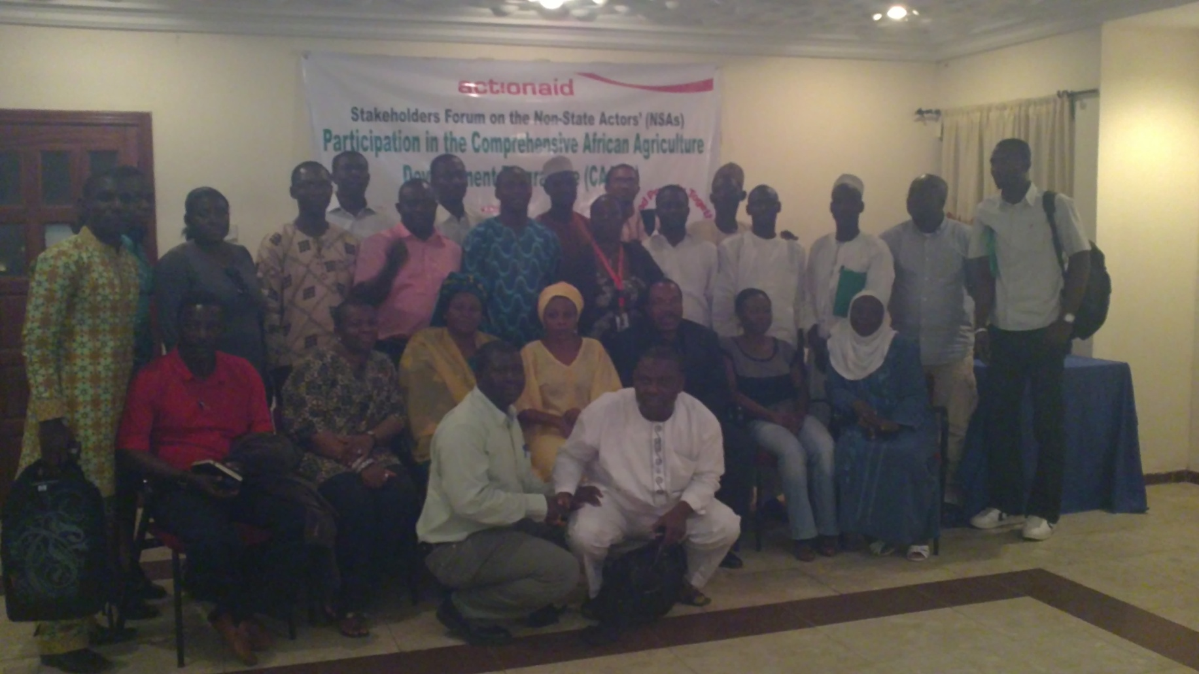
CSO meeting in Nigeria

Slide 12
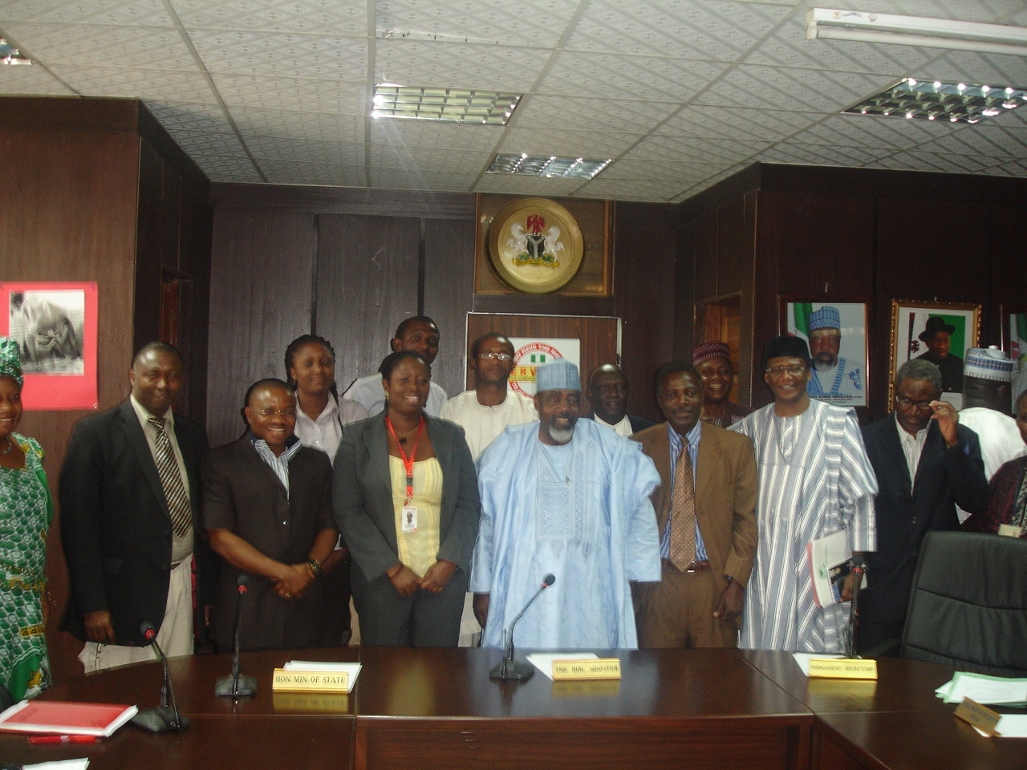
CSOs meeting the minister and presenting communiqué

Slide 13
Lessons learnt
Urgent need for intensified grassroots sensitization and awareness on CAADP
Need to strengthen collaboration and coordination of CSOs for a stronger voice
Need for linking farmer organizations with regional organizations such as ROPPA
Need for increased women participation
Need to include climate change and gender issues in Investment Plans.

Slide 14
Strengthening NSA participation
-A case for Malawi
Problem
NSA not fully engaged in ASWAp (Malawi investment plan for Agriculture)
Intervention
Organize a consultative dialogue platform
Outcomes
Reinvigoration of relationships between NSA and the government
NSA are much clearer on current progress with CAADP/ ASWap
Everyone identified opportunities for NSA to contribute – perhaps a key breakthrough for government
NSA recognise that they need to exercise leadership themselves in engaging strongly with the CAADP process and other partners
The agreed action steps, if implemented, should initiate a much more inclusive country team and boost the contribution of NSA.

Slide 15
Lessons learnt
The emphasis on harmonised, pooled finance is problematic for NSA because the government is more likely to prioritise using funds for government-managed programmes.
FANRPAN’s role in supporting the meeting as a regional organisation was valuable - it promoted peer learning by exchanging examples from across other countries.
The lack of Development Partner engagement in the meeting was a set back
In Malawi, Non State Actors were relatively mature with good levels of legitimacy and accountability but still need to engage and communicate more with government and their constituencies

Slide 16
Next steps
Finalize plan of action in consultation with RECs, NCPA, Development partners and others
For example:
Rollout of the guidelines in priority countries
Targeted dialogues with private sector organisations
Developing strong public private sector partnerships
Carry out advocacy with parliamentarians, women groups,
Capacity development to NSA

